Slide 1


SMART VEHICLE MONITORING SYSTEM USING OPENCV
K.Shunmuga Sundaram, R.Siva Sornaram, A.G.Naveen Kumar, M.Ranjith King Jimson, B.Venkatasamy
SAMUDRA NAYAK – 1911115 COMPS B3

Slide 2
INTRODUCTION
Overcrowding in parking areas due to the increasing number of vehicles, calls for a monitoring system for vehicles from unknown parking and security reasons.
The Automatic Number Plate Recognition System plays a significant role in addressing issues from parking admission, to monitoring vehicle traffic and tracking theft of automobiles.
The proposed system in this paper offers a novel method to detect vehicle monitoring in real-time without any human supervision or any prior knowledge.

Slide 3
The Automatic number plate recognition (ANPR) system will scan the plate. The IoT enabled smart appliance verifies the credentials (once approved), permit them in. The operator receives a video of the vehicle credentials. This smart monitoring system makes use of a microprocessor connected with a Camera and local database to provide high tech monitoring at a low cost.
This proposed product will alert the owner at the time of vehicle entry and takes video of the place at that instant via camera and recognizes the number plate details and owner credentials. It then stores it in an app via the cloud server.

Slide 4
THE PROPOSED PRODUCT
When the vehicle enters the place,
1. Number Plate Detection: The image of the vehicle is captured using a camera and fed to the processing system. The Contour option in OpenCV is used to detect rectangular objects.
2. Character Segmentation: Once the Number Plate is detected, it is cropped out and saved as a new image.
3. Character Recognition: The image is then used to detect the number and characters in the Number plate.
4. Data Acquisition & Transmission: The vehicle number is used to collect the details of the detected vehicle and then is sent to the app via the cloud.

Slide 5
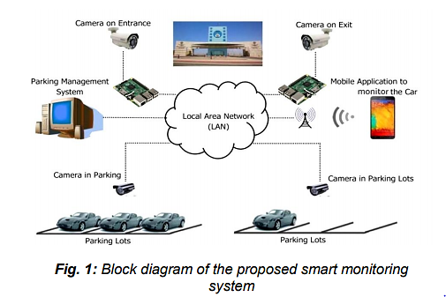

Slide 6
COMPONENTS
HARDWARE:
Raspberry Pi: The Raspberry Pi is a mini-computer that runs Linux, but it also provides a set of GPIO pins that allow you to control electronic components for physical computing and explore the Internet of Things.
SOFTWARE:
MySQL is the language that is used to create, modify the database.
Netbeans is an Integrated Development Environment that is used to write and debug code.
Xammp is a GUI tool that is used to create and manage the database in a user-friendly environment.

Slide 7
IMPLEMENTATION
Number Plate Detection
First, the image is resized to the required size, and then it is greyscaled.
The Number plate is useful data, and other information is considered as mere useless. Usually, a bilateral filter (Blurring) is used to remove the unnecessary details from the image.
Then the Canny Edge method is used to perform edge detection in the image.
As the location of the number plate is determined, the remaining useless information is masked. Now the entire picture except the number plate is masked.

Slide 8
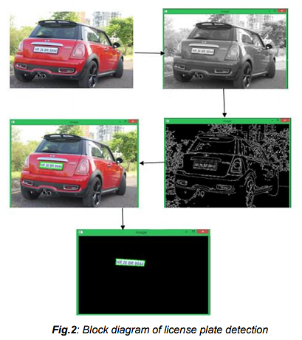

Slide 9
Character Segmentation
The license plate is segmented out of the image, and it is cropped and saved as a new image using ANPR in Raspberry Pi.
Character Recognition
The last step in this ANPR using Raspberry Pi is to read the number plate information from the segmented image. Tesseract package in Open CV is used to read characters from the image.
Data Acquisition & Transmission
The details are collected from the database using Python Mysql connector and sent to the app developed using android studio.

Slide 10
CONCLUSION
An ANPR system encourages a smoother parking process and an easier way to manage site security for employees and guests.
The aim is to monitor vehicles without any human intervention and send the details to the person in charge of the place at the time of vehicle entry.
This can potentially improve staffing, develop better procedures, provide better service, and reduce the organization's liability.

Slide 11
BIBLIOGRAPHY
[1] Oz and F. Ercal, ―A practical license plate recognition system for real-time environments,‖ in Proc. IWANN, vol. 3512. Berlin, Germany: Springer-Verlag, pp. 881–888, 2005.
[2] A.Rahman, W. Badawy, and A. Radmanesh, ―A realtime vehicle‟s license plate recognition system,‖ in Proc. IEEE Conf. Advanced Video Signal Based Surveillance, pp. 163–166, 2004.
[3] F. Yang and Z. Ma, ―Vehicle license plate location based on histogramming and mathematical morphology,‖ in Proc. 4th IEEE Workshop Autom. Identification Advanced Technol., pp. 89–94, 2005.
[4] Prof. D.D.Pukale,Palak Chauhan,Adhikari Siddhi Satish,Preeti Nawal, Newha Kumari, ―Density Based Traffic Control System Using Video Processing,‖ Imperial Journal of Interdisciplinary Research (IJIR),Vol-2,Issue-6, 2016.
[5] Mr. Avinash Gadekar, Mr. Paresh Joshi, Mr. Ravindra Ardhapure, Mr. Shankar Waghmare, Prof. Namarata Jadhao. ”Review : Smart Traffic signal Management system using Image Processing”. Volume :4 issue 10/ Oct-2017.
[6] B. Hari Kumar, Syeda Fathima Tehseen, Vehicle Monitoring and Tracking System using GPS and GSM Technologies, International Research Journal of Engineering and Technology (IRJET), Volume: 03 Issue: 04 | Apr-2016
[7] Singhal, Sarishma, and R. Tomar, "Intelligent accident management system using IoT and cloud computing," 2016 2nd International Conference on Next Generation Computing Technologies (NGCT), Dehradun, 2016, pp. 89-92.
[8] Prashant A. Shinde, Y.B. Mane ―Advanced vehicle monitoring and tracking system based on Raspberry Pi,‖ IEEE 9th International Conference on Intelligent Systems and Control (ISCO), 2015
[9] Mithileysh Sathiyanarayanan, Santosh Mahendra, Rajesh Babu Vasu, ―Smart Security System for Vehicles using Internet of Things (IoT),‖ Published in Second International Conference on Green Computing and Internet of Things (ICGCIoT),2018.
[10] Shabbir Bhusari, Sumit Patil, Mandar Kalbhor. ―Traffic Control System using raspberry-pi,‖ International Journal Of Advanced Engineering Technologies

